Slide 1
The effect of emotive text in trial recruitment
By Fernando Santos

Slide 2
The Question
Does exists a correlation between the emotive text in
Patient Information Leaflets and the clinical trials’ recruitment rates?

Slide 3
Our research approach
Gather a selection of trials in which the PIL should have an influence in the patient decision
Evaluate the Emotive Content Level present on the PIL
Employ a Regression Model to identify significant associations between the ECL and the Trial’s Recruited Sample Proportion
Employ Cluster Analysis to visualize the emotive associations between words and the PILs
Employ Cluster Analysis to identify potential influential words in the PILs
Employ a Regression model to evaluate the influence level of the words
Employ the NRC emotive Lexicon to identify emotive associations present in the influential words

Slide 4
Gathering the data
The NETSCC department of the Wessex Institute provided the following information for this research:
A dataset with general information on 181 clinical trials sponsored by the HTA between 1995 and 2012.
A set of 66 PIL Protocol and Monograph PDFs for clinical trials oriented in patient randomization.
Additionally, the public domain NRC Emotion Lexicon was employed.

Slide 5
Evaluating the emotive content
To objectively measure the emotive text present in the leaflets the following steps were required:
Obtain the leaflet text from the provided PDFs
Identify the emotive words present in the text
Quantify the emotive associations of those words

Slide 6
Pos
Tru
Ang
Sad
Ant
Difficulty
Sur
Joy
Fear
Dis
Neg
id | ProjRef | Pos | Neg | Ang | Ant | Dis | Fear | Joy | Sad | Sur | Tru
6 | 01/13/03 | 84 | 22 | 6 | 18 | 3 | 12 | 3 | 16 | 9 | 34

Slide 7
Quantifying the emotive associations
In this step, we employ a linear regression model to measure the statistical significance between the recruited proportion of the sample trial and the following variables:
Original independent variables present in the dataset
A subset of independent variables obtained from the previous set
The level emotive text present in the leaflets

Slide 8
Cluster Visualization
A bipartite graph was created in which:
Leaflets were represented as circles coloured red when the trial failed to recruit at least 80% of the planned sample and blue otherwise.
Words were represented by dots which position and colour varied by:
Its rate of appearance in successful leaflets vs unsuccessful ones
Its ratio of appearance in successful leaflets vs unsuccessful ones

Slide 9
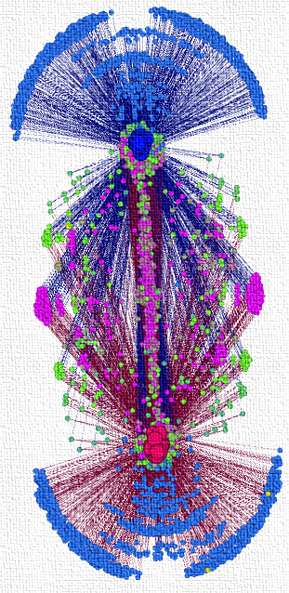

Slide 10

Cluster Analysis: Similarity metric
The first metric measures how similar are the word appearance rates in successful and unsuccessful leaflets: In how many successful leaflets it appears vs in how many unsuccessful ones.
The second measures how many total appearances the word has in successful vs unsuccessful leaflets.
This two measures are obtained by a derivative of the Jaccard similarity formula:
$J\left(A,B\right)=\frac{|A∩B|}{|A∪B|}→\frac{\left|A\right|−|B|}{|A∪B|}$

Slide 11
Cluster Analysis: K-Means
K-Means is a clustering heuristic which follows a simple algorithm:
Select a set of k observations as starting points for the clusters
Assign the observations to the cluster with the closest Euclidean distance.
Calculate the new means for the cluster centroids and repeat step 2 until the algorithm converges.
Applying this technique a set of 353 words were identified as potentially significant predictors on the recruited sample proportion.

Slide 12

Quantifying the Words’ Significance
A linear regression model was employed to evaluate the statistical significance of the words identified as predictors of the recruited sample proportion.
A set of 23 influential words was obtained capable of predicting 94% of the dependent variable. Relevant literature suggest 23 predictors would require at least $N>50+8m$ case observations. With only two predictors the best model accounted for 27% of the recruited proportion.

Slide 13
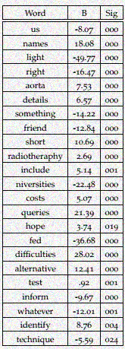

Slide 14
Identifying Emotive Associations within the Influential Words
A brief analysis of the 23 words was made and the following associations were found:
Only 9 words were found accounted in the lexicon in the original written form
Another 4 words were present as derivatives (singular form)
From the 13 words 6 had at least one emotive association

Slide 15
Conclusions
The Leaflets appear to have a low emotive content level. This may be due because the researchers procure to employ objective & specific language.
There is evidence patients find the leaflets boring and hard to understand. This could be an effect of a lower than expected emotive level.
The Leaflets appear to have no significant correlation with the recruitment rates in trials
This could imply that the leaflets do not have a significant influence in the patient decision which brings into question the patient informed consent.

